Slide 1
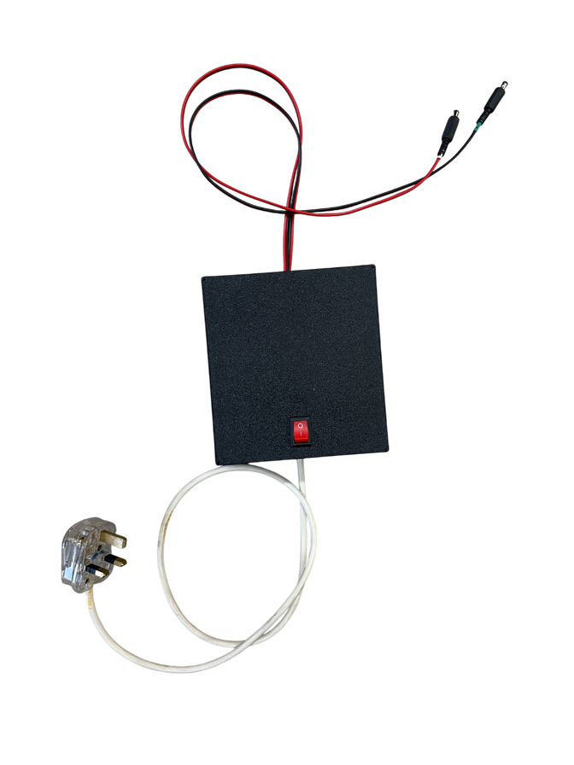


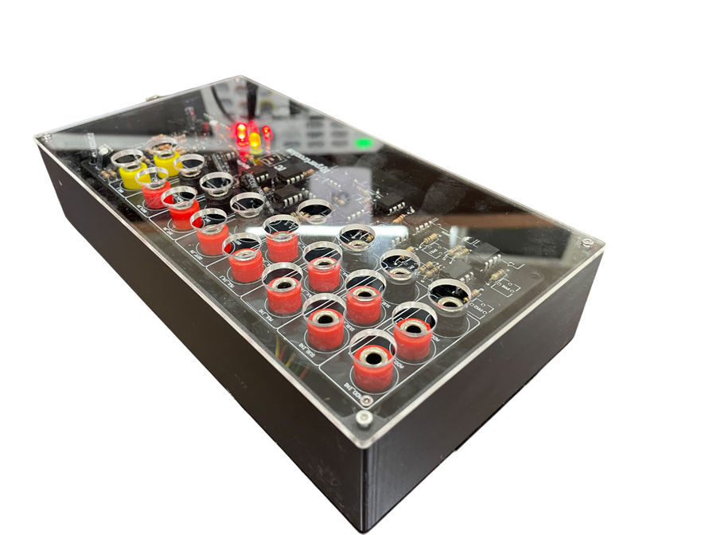

ANALOG
EN2091 - Laboratory Practice and Projects
ANALOG
COMPUTER
TEAM HYPERTRONICS
COMPUTER
230726L - Wijesinghe.U.G.S.K.D
230724E - Wijesekara.W.A.G.S.
230659H - Upekshani.T.S.
230147L - Dilhara.D.S
01

Slide 2

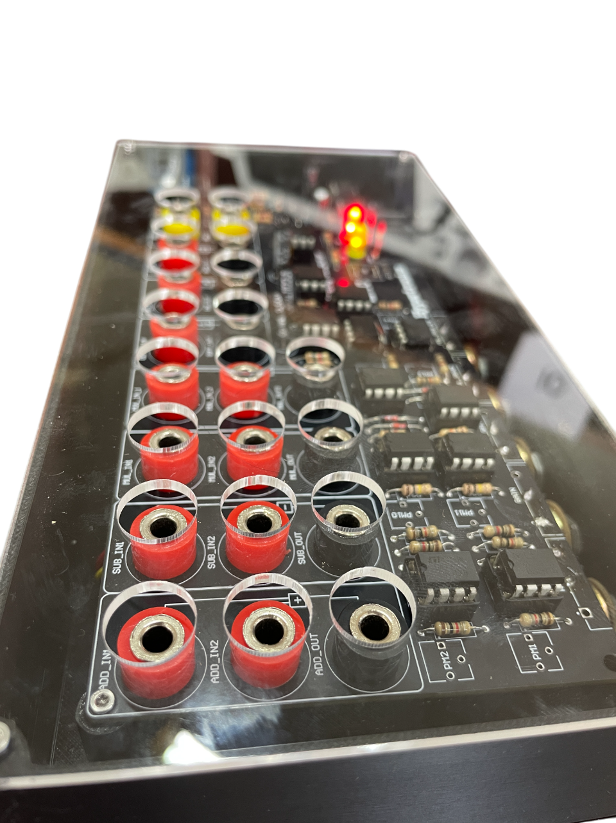
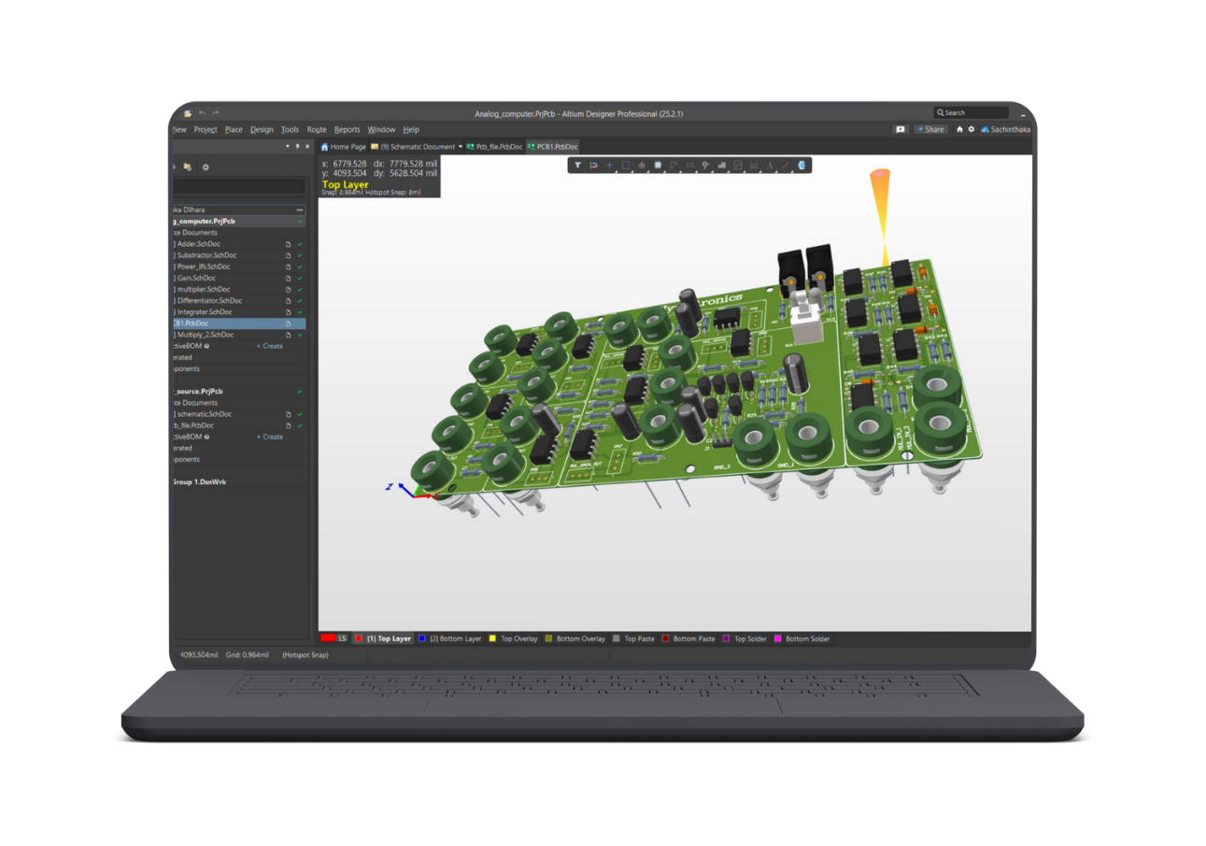
PROJECT
INTRODUCTION
Our project aims to demonstrate the functionality of op-amp circuits in performing fundamental analog computations such as:
addition
subtraction
multiplication
integration
differentiation
within the 1 Hz to 10 kHz frequency range. It consists of a dual-channel input interface for each operation with control mechanisms for easily adjustable gain and is powered by a stable and clean power supply system, which acts as a separate module.
02

Slide 3

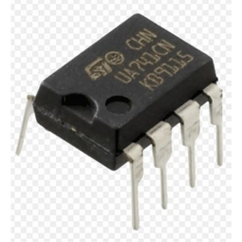
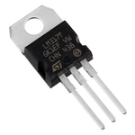

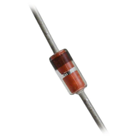
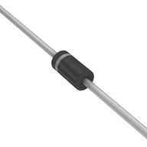
COMPONENTS
& WHY?
UA741
LM7812/LM7912(Option02)
General Purpose OP-Amp
Fixed 12v voltage regulator
Widely available and affordable. • Ideal for basic operations like addition, subtraction
Bandwidth (∼ 1 MHz) is sufficient for 1 kHz to 10 kHz signals.
Stable and easy to implement without complex compensation.
cheap and widely available
regulator circuit is simple,not complicated like Adjustable regulator
IN4007
IN4148
Diode
Diode
cheap and widely available
Withstands up to 1000 V (Peak Reverse Voltage), making it ideal for AC to DC rectifier applications
Can handle 1 A continuous current
Widely available and affordable
IN4148 works linearly at low currents; 1N4007 doesn’t.
Faster response: 1N4148 has low junction capacitance and fast switching.
1N4148 has lower leakage and better temperature stability for small signals.
03

Slide 4
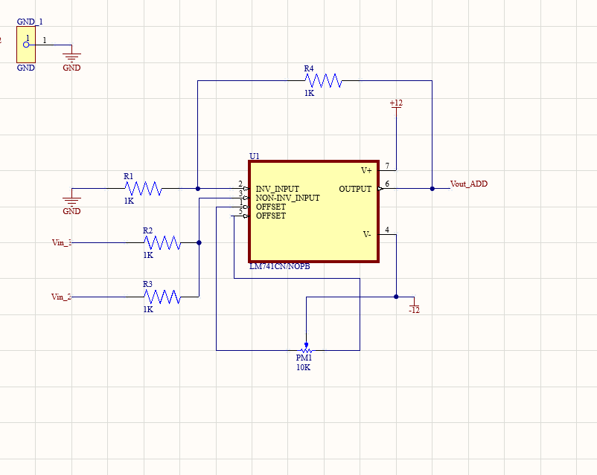


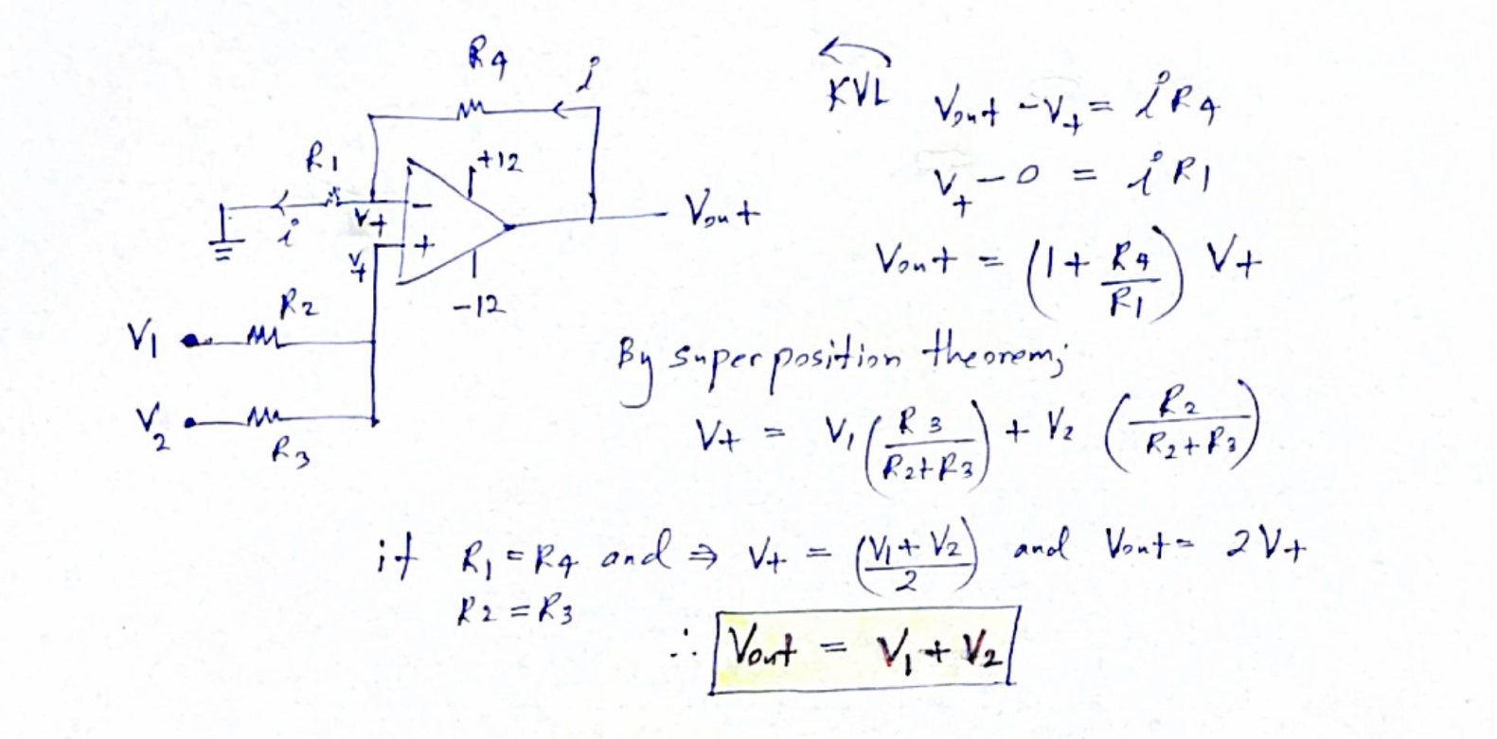
WHY 1KOHM RESISTORS?
Small resistors, such as 100 Ω, draw more current compared to 1 kΩ resistors, leading to increased power consumption. While higher resistances, like 10 kΩ, are permissible, they tend to produce lower bandwidth. Utilizing very high values, such as 100 kΩ, can even filter out portions of the input signal. Consequently, a 1 kΩ resistor serves as an excellent choice in this scenario.
ADDER
CIRCUIT
04

Slide 5
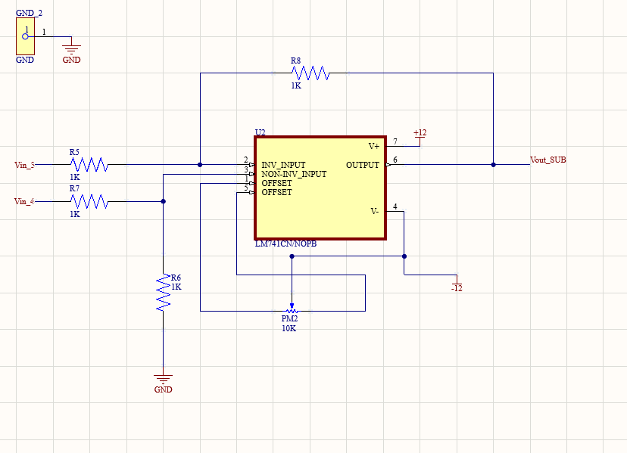
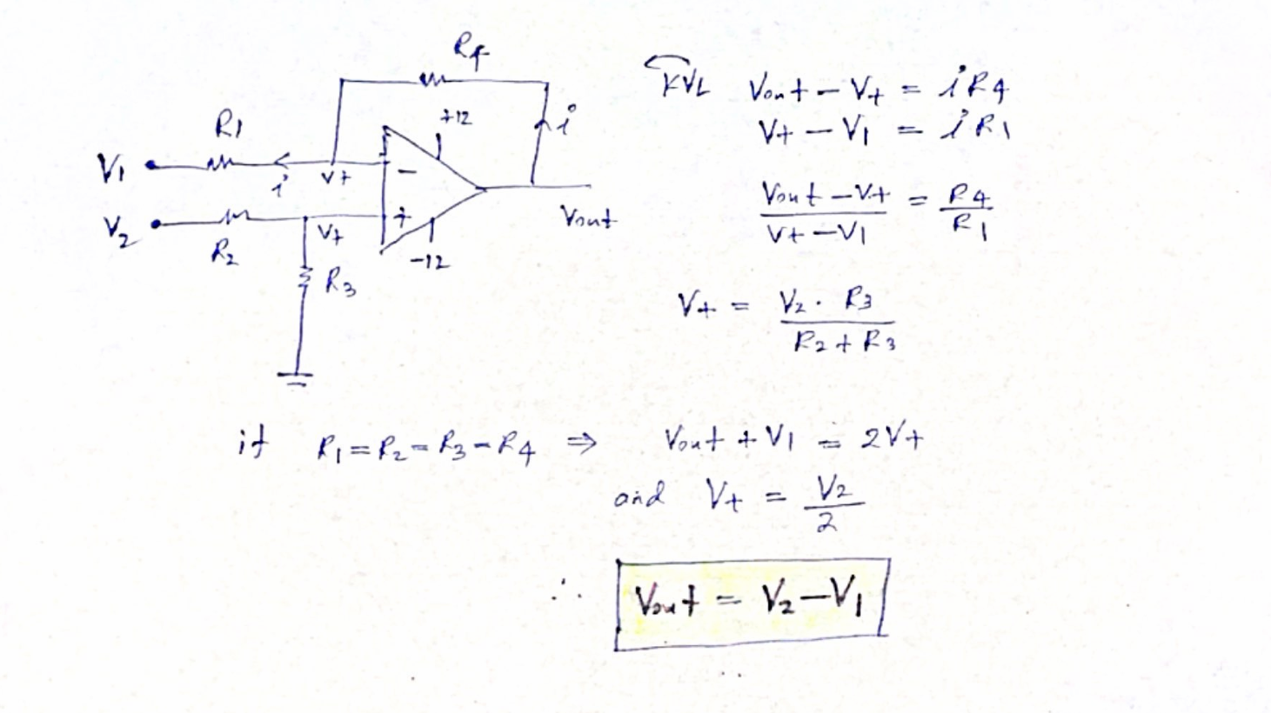
WHY 1KOHM RESISTORS?
Small resistors, like 100 Ω, draw more current compared to 1 kΩ, which leads to increased power consumption. While higher resistors, such as 10 kΩ, are permissible, they tend to offer lower bandwidth. If we opt for an excessively high value, like 100 kΩ, it may filter out certain portions of the input signal. Thus, a 1 kΩ resistor is an excellent choice in this scenario.
SUBTRACTOR
CIRCUIT
05

Slide 6
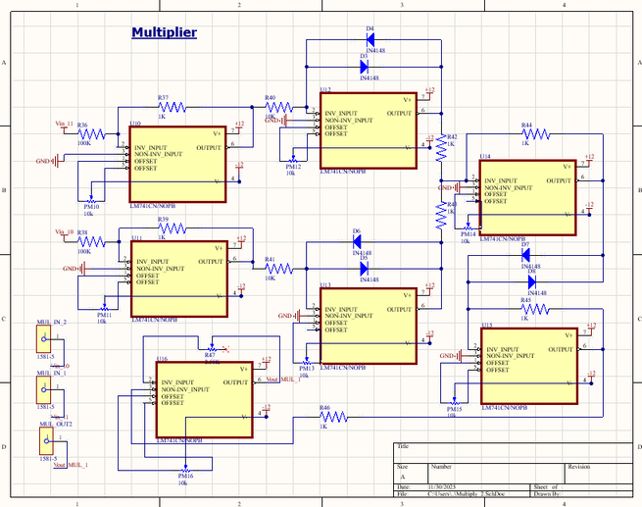
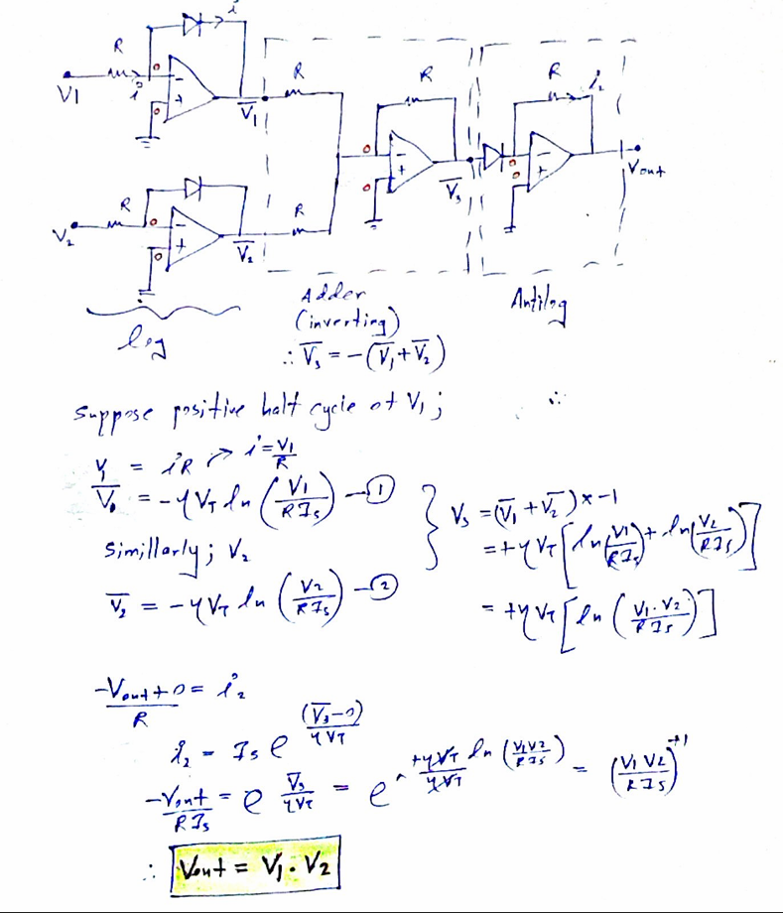
MULTIPLIER
CIRCUIT
WHY HIGHER INPUT RESISTORS?
In log/antilog multipliers, using large resistors helps ensure that the input voltage generates a small current. This approach maintains a more linear and predictable log function.
06

Slide 7
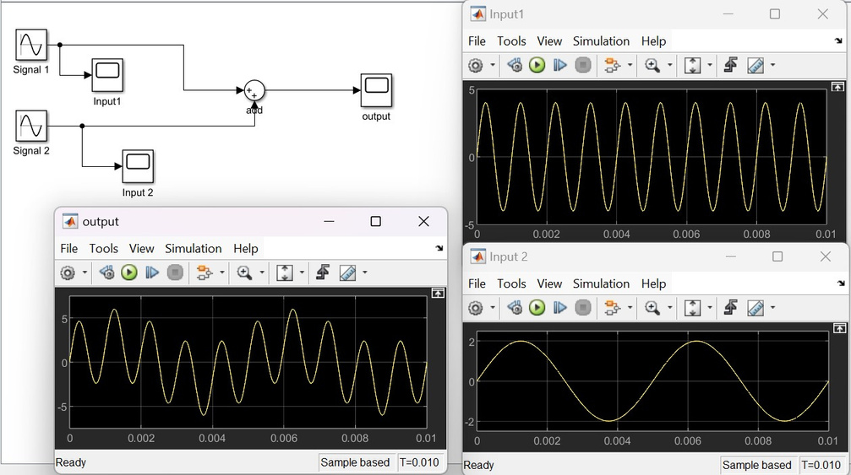
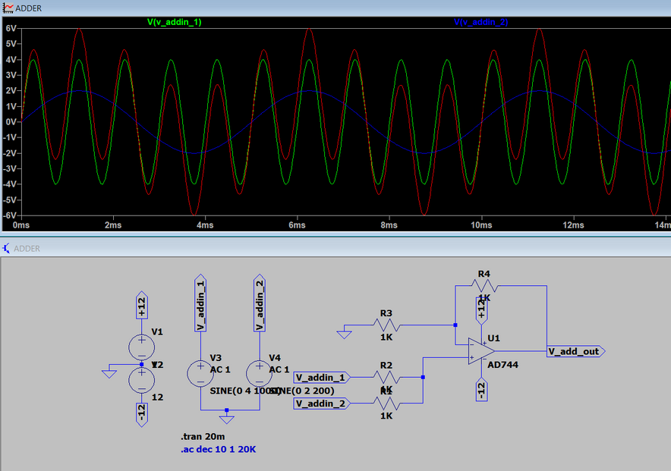
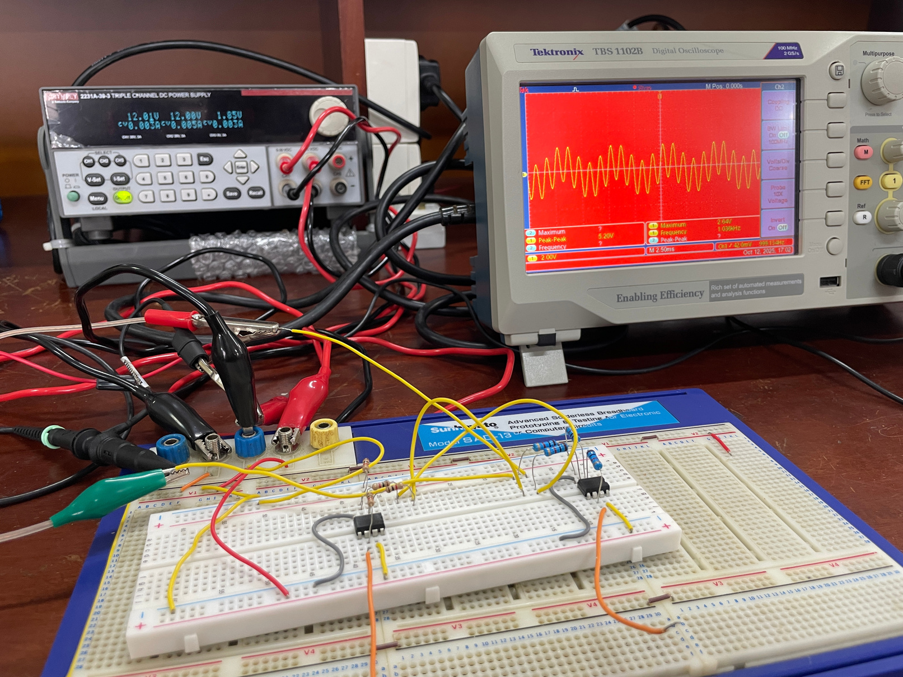
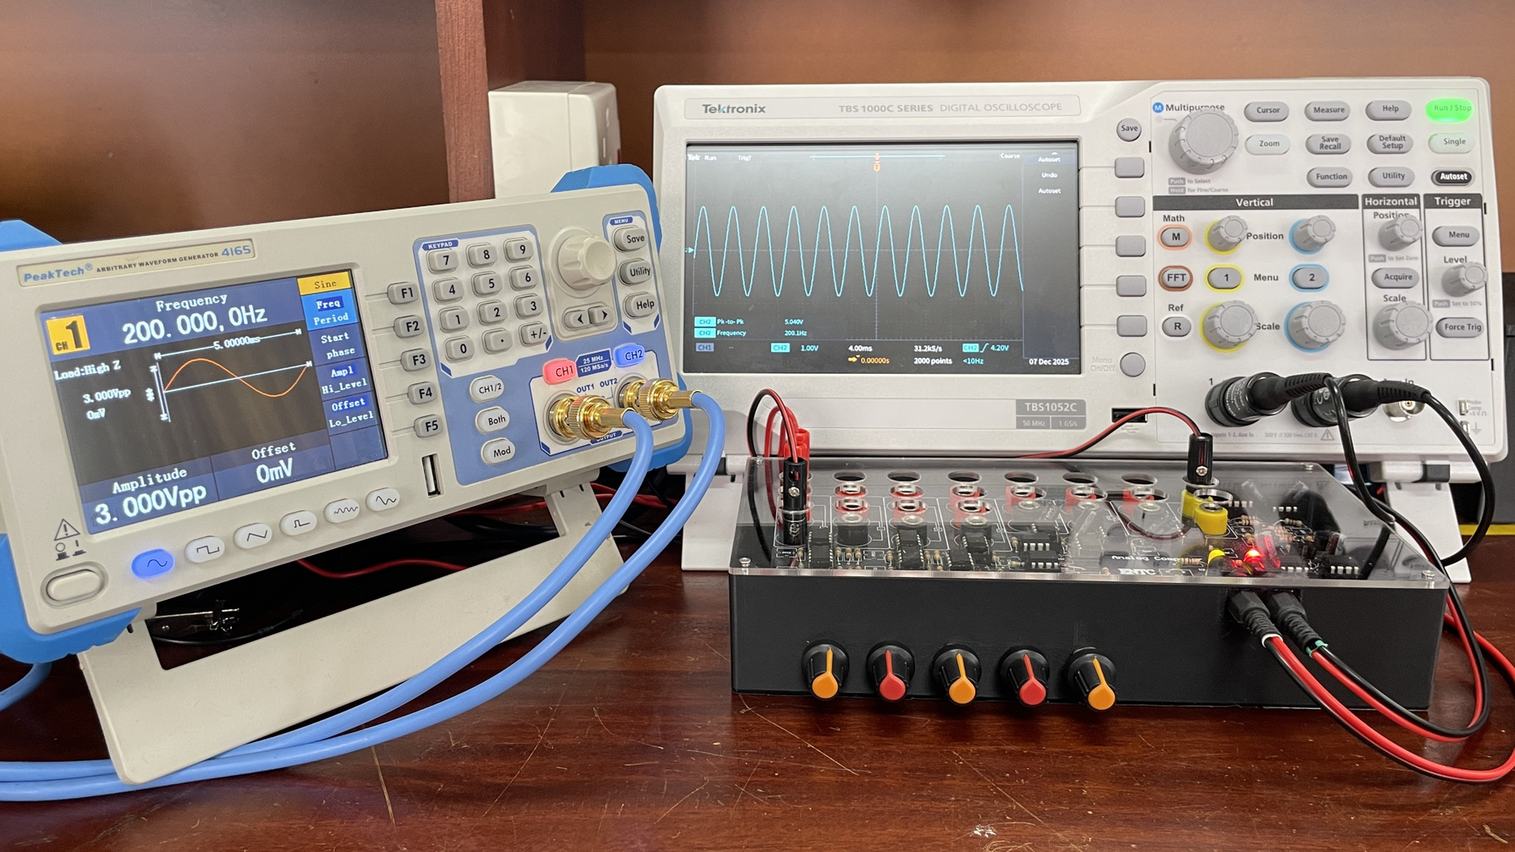
ADDER
SIMULATION RESULTS &
BREADBOARD/FINAL IMPLEMENTATION
SIMULINK
LT-SPICE
BREADBOARD IMPLEMENTATION
FINAL IMPLEMENTATION
07

Slide 8
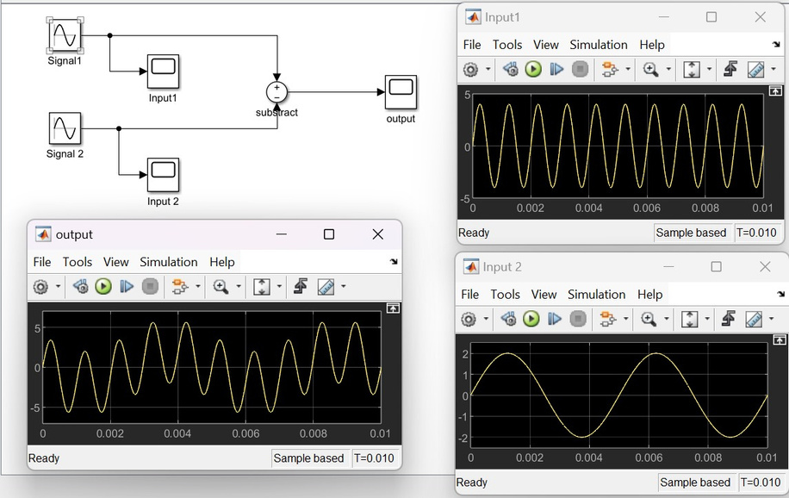
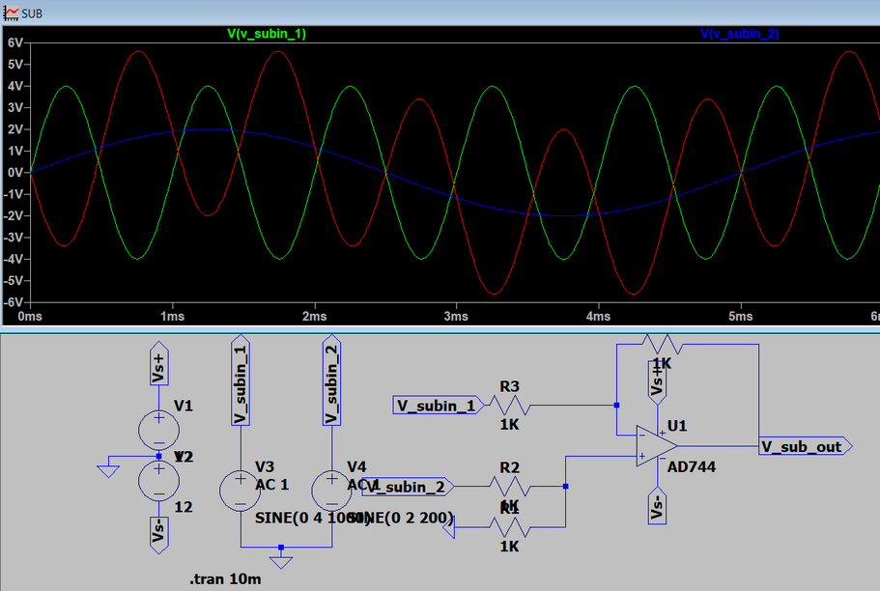
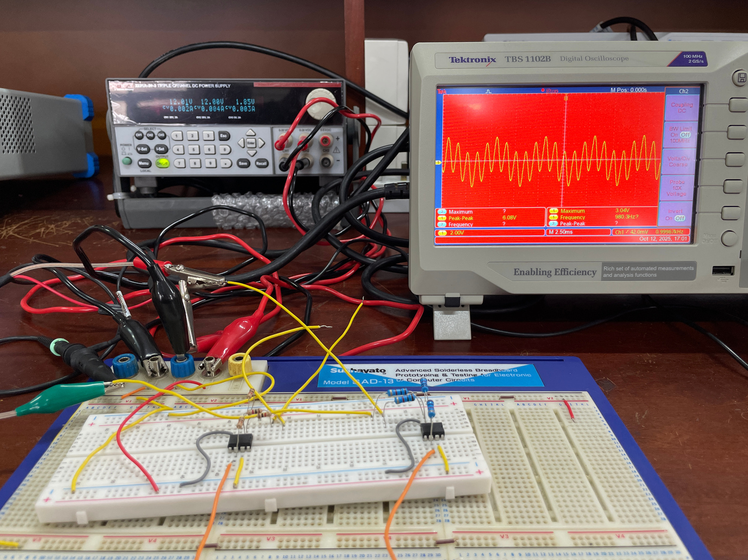
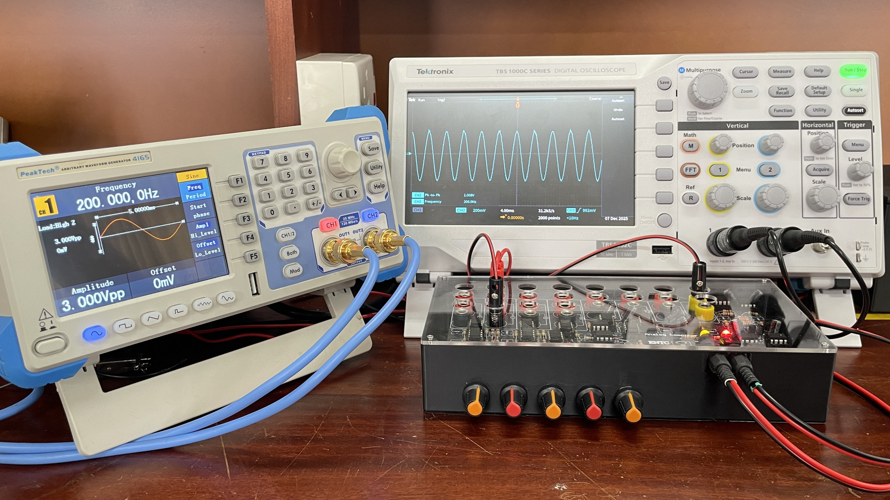
SUBTRACTOR
SIMULATION RESULTS &
BREADBOARD/FINAL IMPLEMENTATION
SIMULINK
LT-SPICE
BREADBOARD IMPLEMENTATION
FINAL IMPLEMENTATION
08

Slide 9
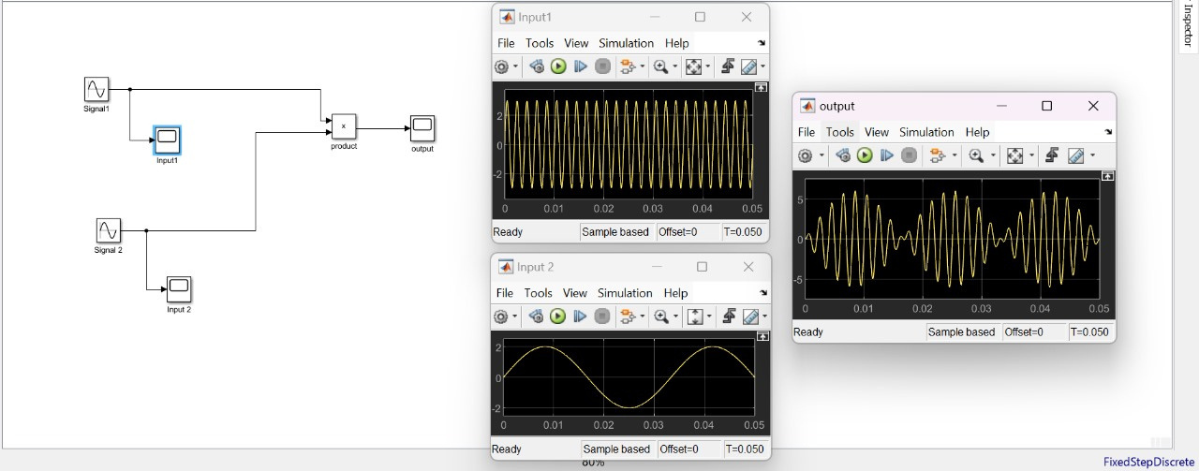
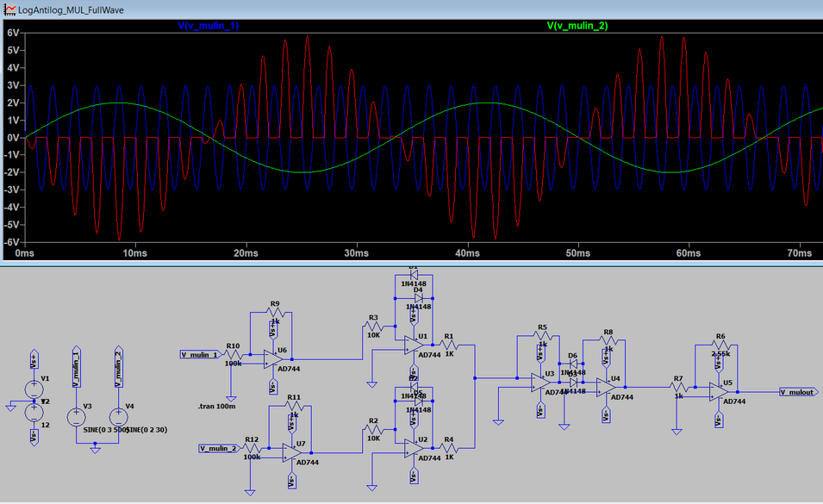
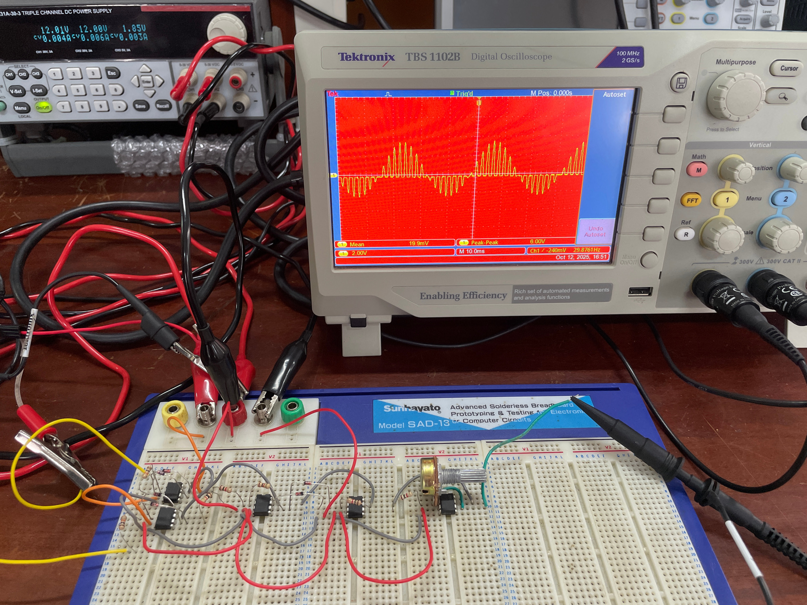
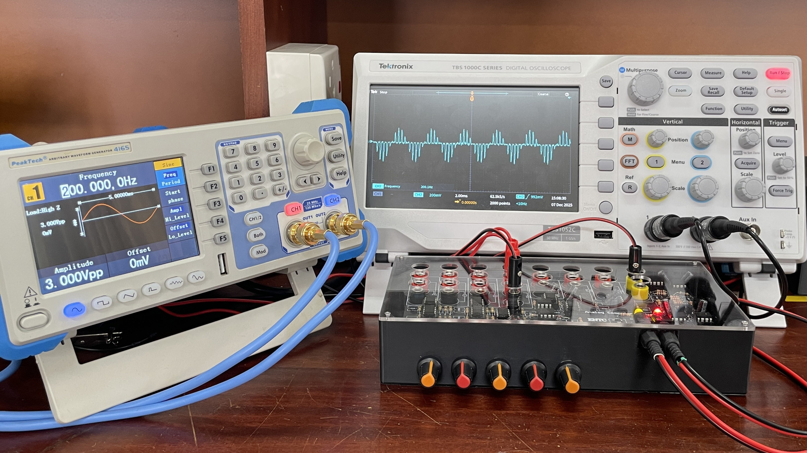
MULTIPLIER
SIMULATION RESULTS &
BREADBOARD/FINAL IMPLEMENTATION
SIMULINK
LT-SPICE
BREADBOARD IMPLEMENTATION
FINAL IMPLEMENTATION
09

Slide 10
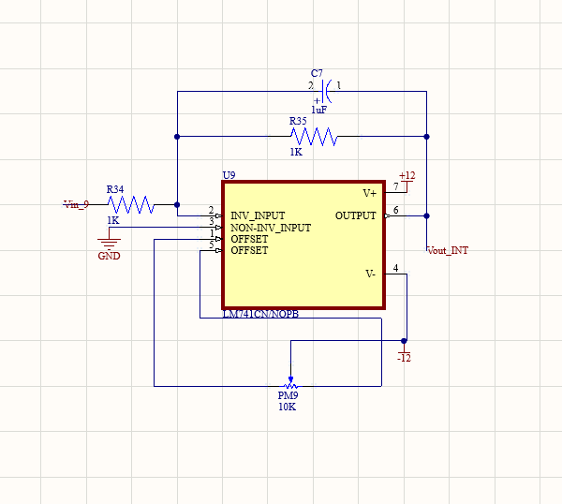
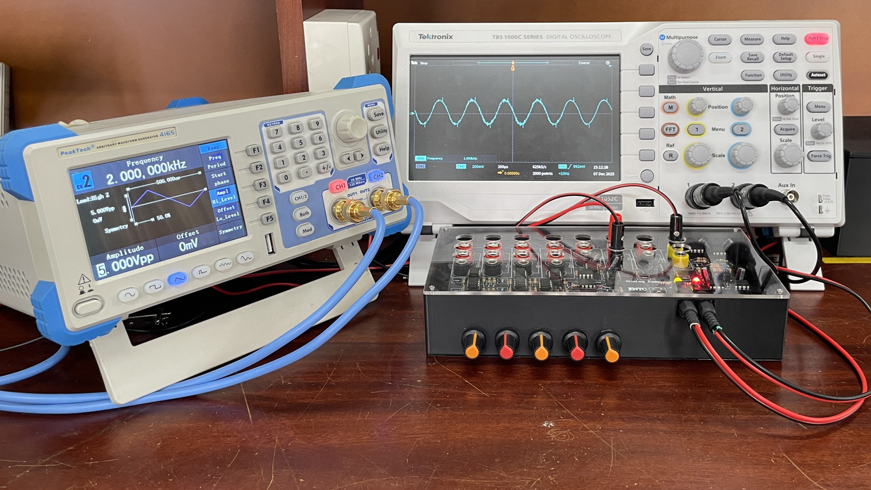
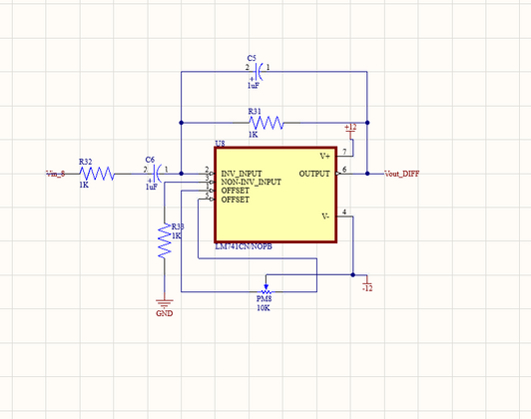
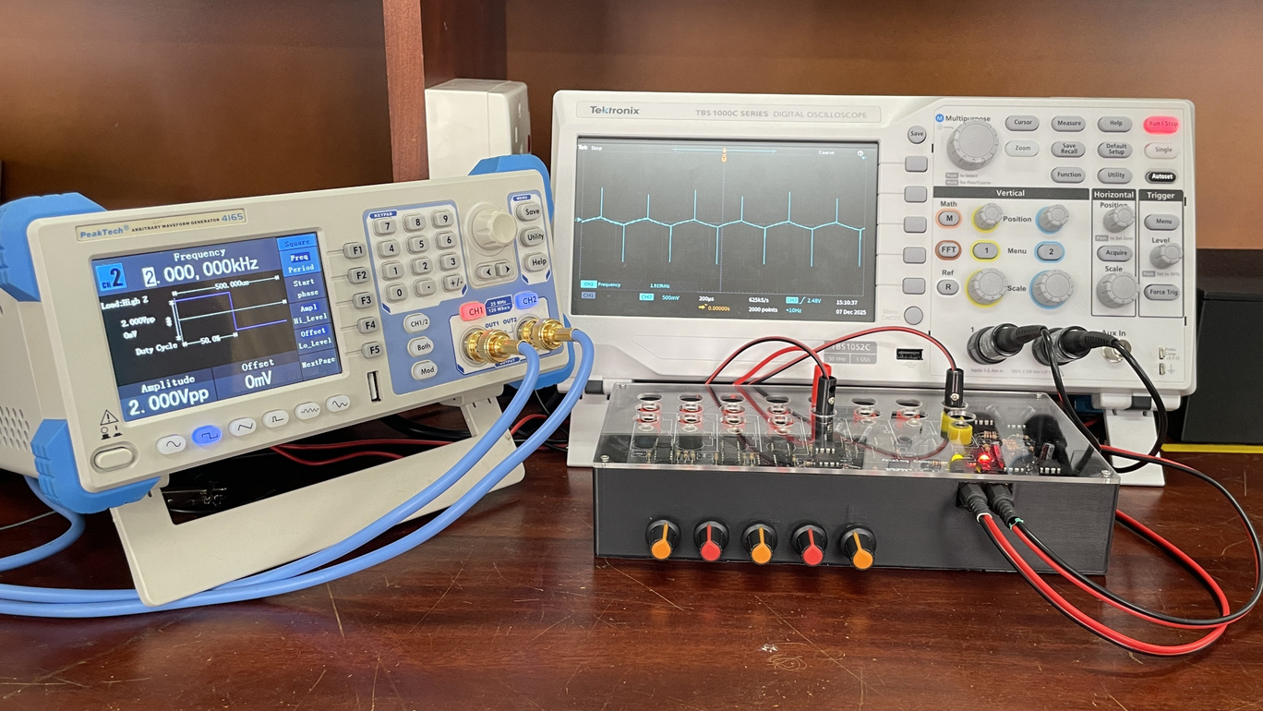
ADDITIONAL
CIRCUITS
INTEGRATOR
DIFFERENTIATOR
15

Slide 11
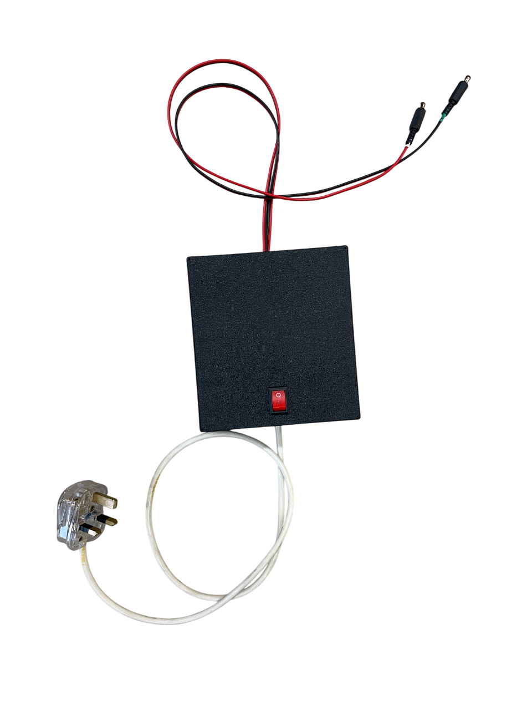
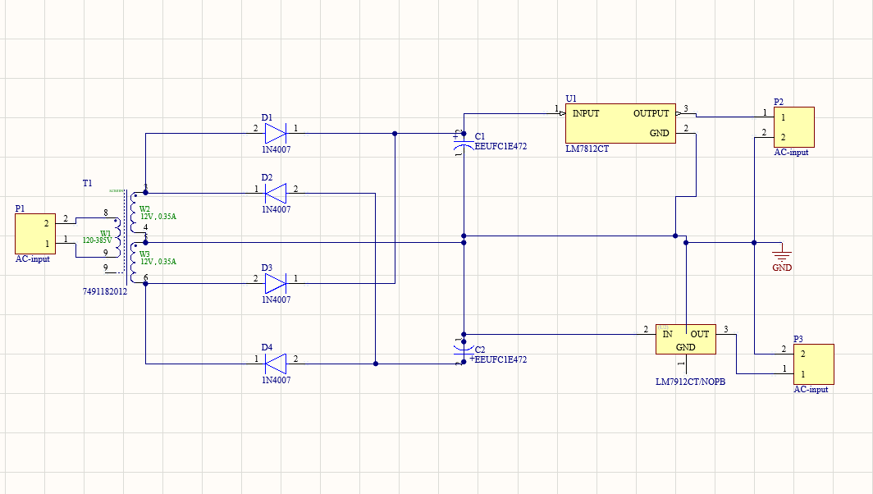
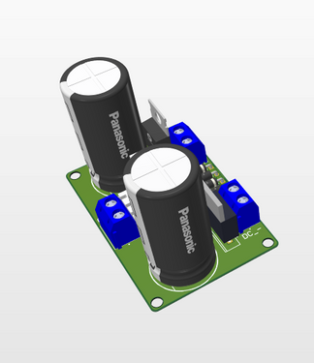
POWER SUPPLY
FIXED ±12V
14

Slide 12
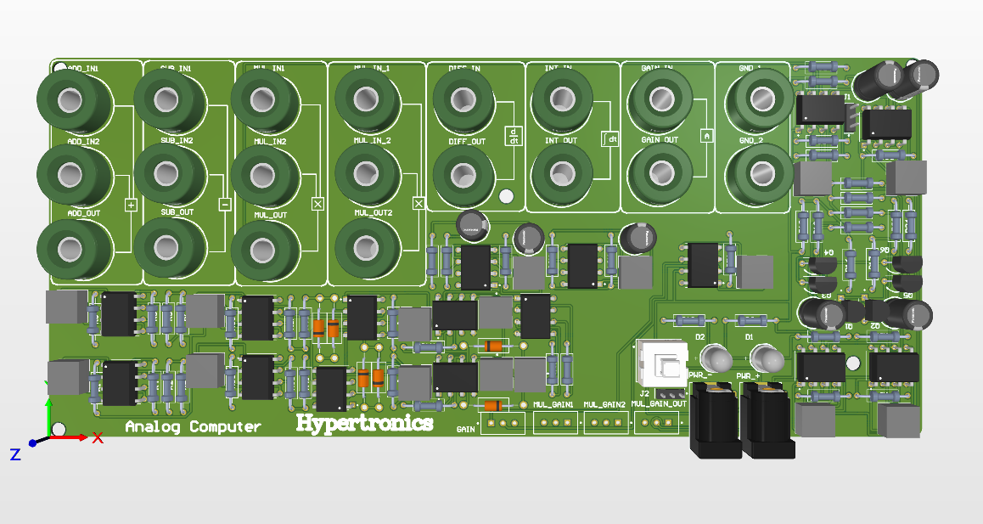
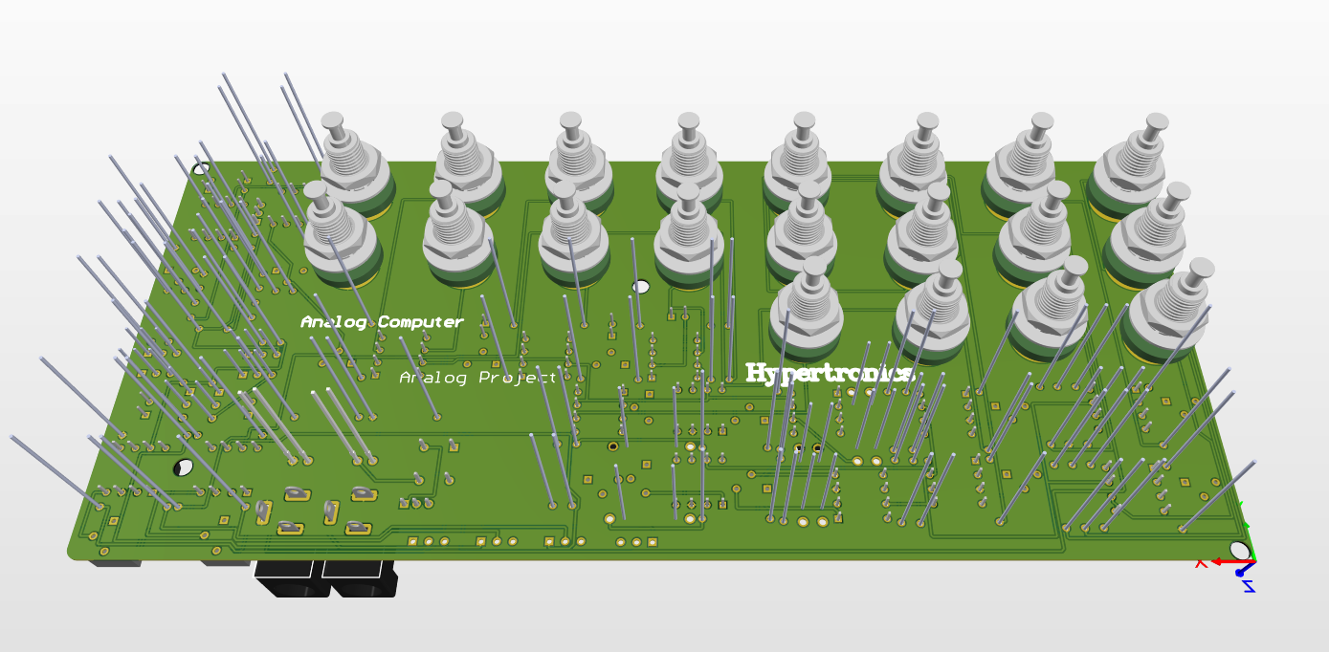
PCB
DESIGN
05

Slide 13
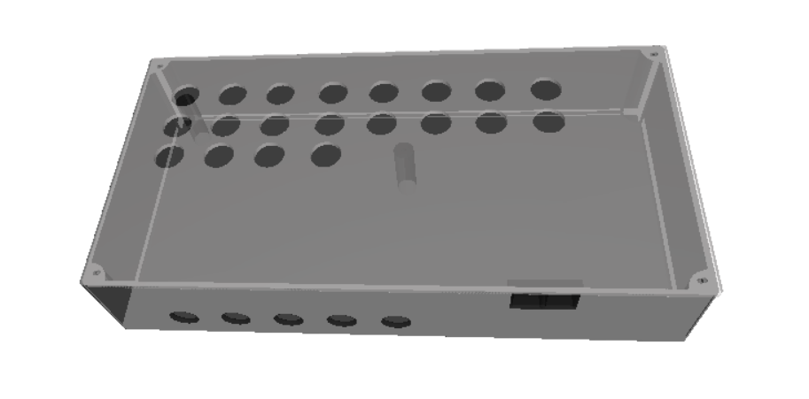
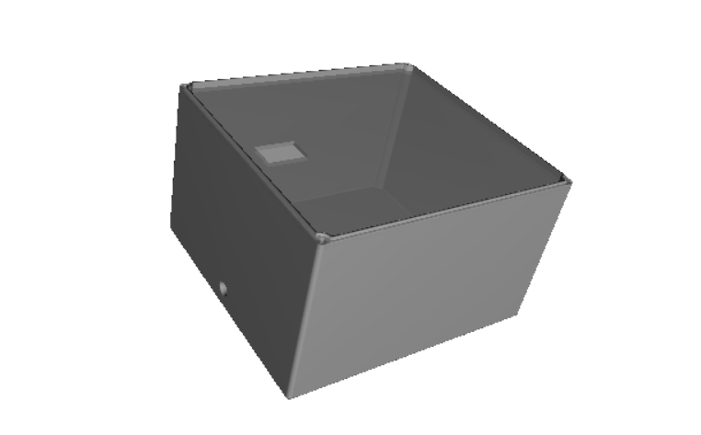
ENCLOSURE
DESIGN
05

Slide 14
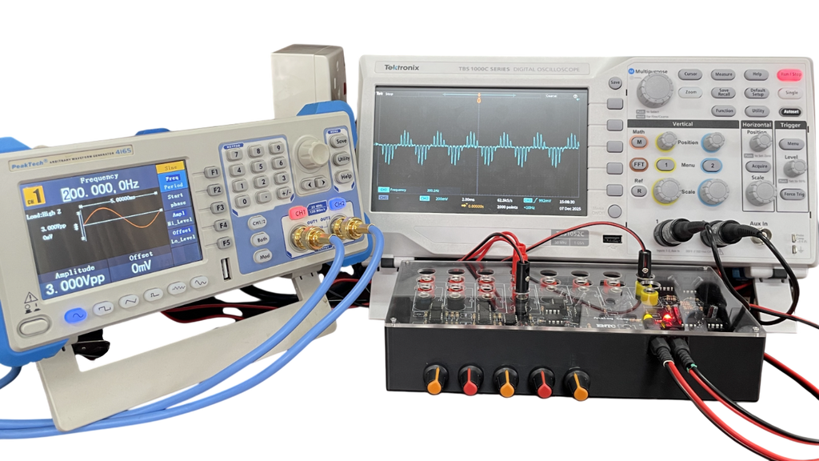
CHALLENGES & RESULTS
We Achieved the expected results with the project.
Our Main challenge was the mismatch among BJTs in the Gilbert cell led to unexpected non-linear behavior in the multiplier circuit.
We Overcome that issure by Replacing the Gilbert cell with a Log–Antilog multiplier with some modifications.
It Improved linearity and allowed the circuit to produce the desired output.
08

Slide 15
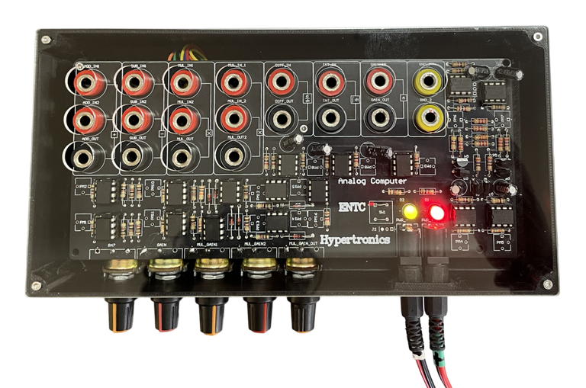
DEVICE
PARAMETERS
Maximum Supply Voltage ±18v(±12v Recommended)
Maximum input Current 10mA
Max/Min output Voltage ±12V
Bandwidth 1-10kHz
Maximum Noise Level 100mV
Accuracy ±(1-10)%
Maximum Gain x10
12

Slide 16




TASK
ALLOCATION
230726L
230147L
Wijesinghe.U.G.S.K.D
DILHARA.D.S
Simulation & component selection
PCB schematic design
PCB design
breadboard implementation
230724E
230659H
Wijesekara.W.A.G.S
UPEKSHANI T. S.
powersupply design
soldering
Enclosure Design
breadboard implementation
16

Slide 17
THANK
YOU
TEAM HYPERTRONICS
17

